Slide 1

Language model that semantically captures masked glycoprotein amino-acid mutations in emerging variants of the SARS-CoV-2 virus
Mentor:
Phd Prof. Nevena Ackovska
Student:
Kiril Zelenkovski

Slide 2
PROJECT CONTENT
01
02
03
1. Introduction
SARS-CoV-2 emergence
Importance of the glycoprotein
2. Dataset
Data interpretation
Data acquisition [GISAID]
Data preprocessing
Data analysis
3. Models, Reults
Transformers architecture
Results and discussion

Slide 3
1. Introduction
How did SARS-CoV-2 happen?
What does the anatomy look like?
How important is the S-gene?

Slide 4
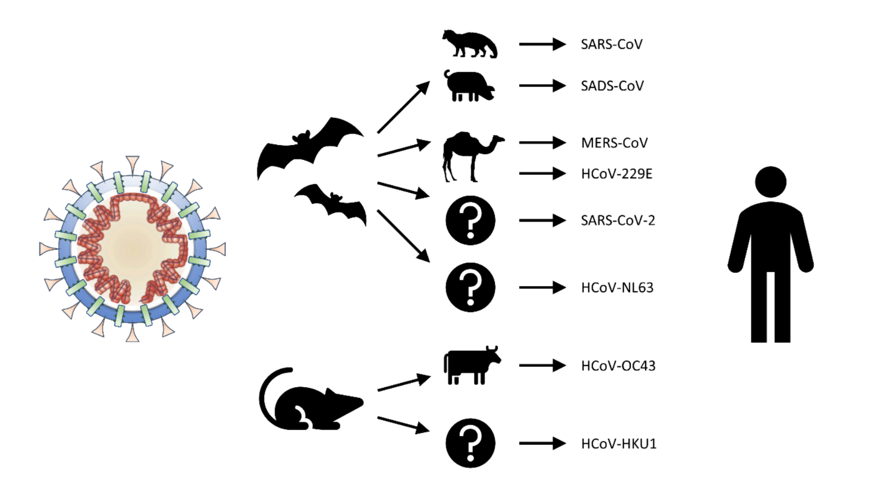
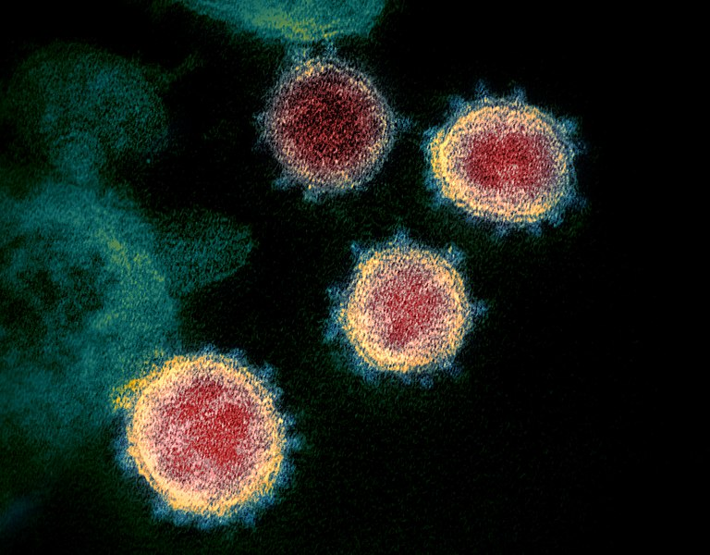
SARS-CoV-2
Fig1. This transmission electron microscope image shows SARS-CoV-2
Fig2. Zootonic spillover, possible intermediate hosts

Slide 5
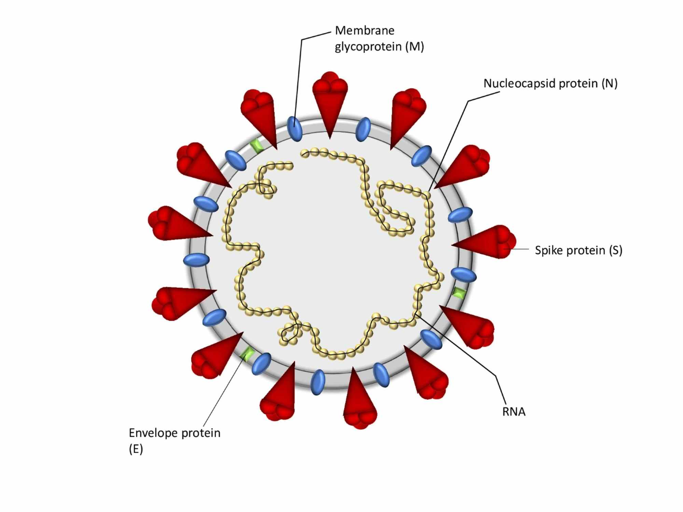
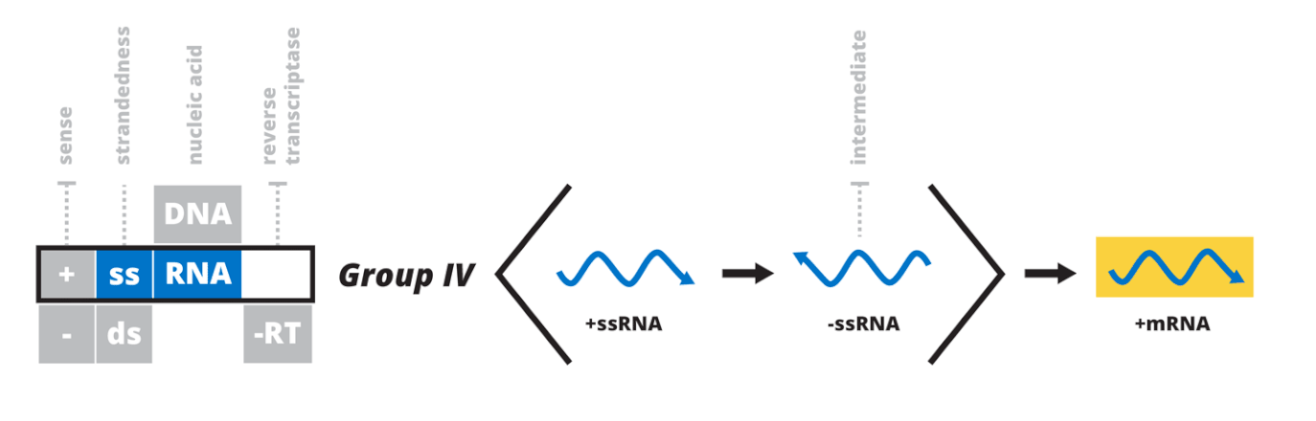
Anatomy of the SARS-CoV-2
01
Fig3. Viral particle of the SARS-CoV-2
Fig4. Baltimore classification for the positive sense single-stranded RNA viruses

Slide 6

01
+ssRNA
Fig5. SARS-CoV-2 isolate chart Wuhan-Hu-1; complete genome

Slide 7
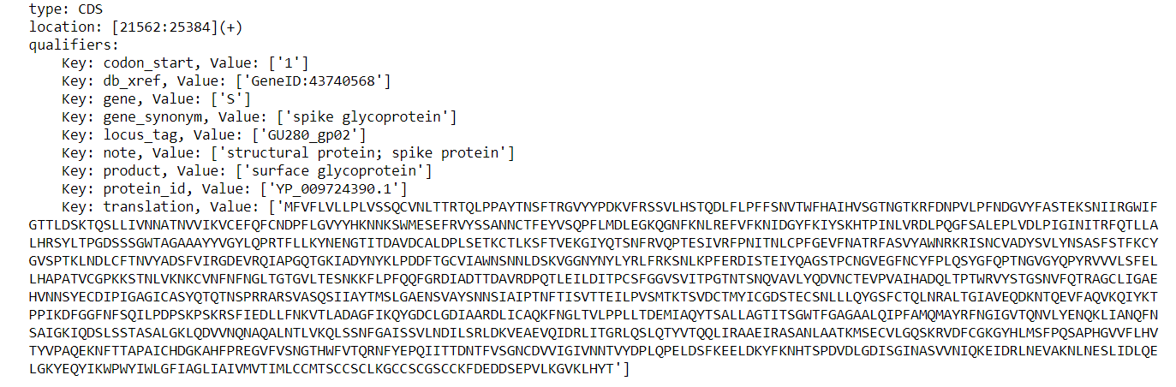

Slide 8
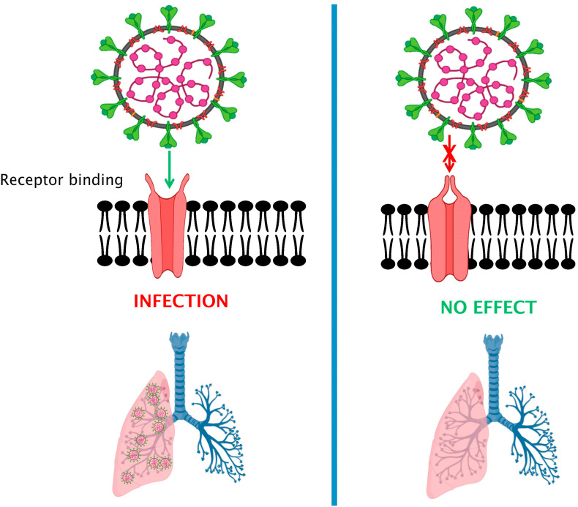
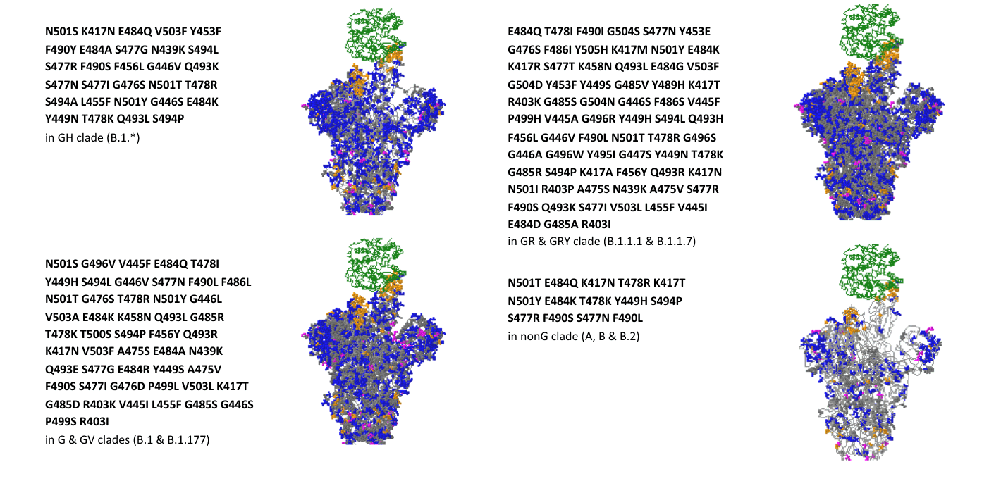
SARS-CoV-2 binding cites
01
Fig5. Different interactions between CoVs and their cellular receptors[source]
Fig6. Receptor binding surveillance for complete genomes [GISAID]

Slide 9
2. Dataset
Data interpretation: Lineages / Variants
Data acquisition pipeline[GISAID]
Data preprocessing
Data analysis

Slide 10
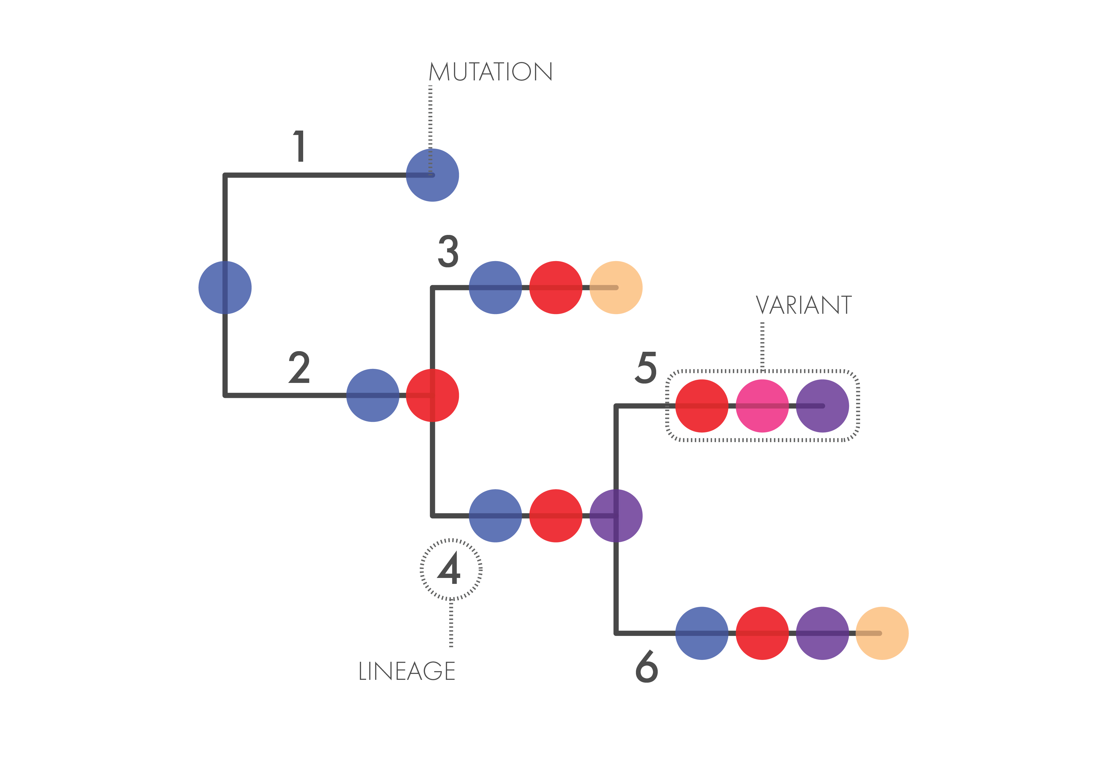
01
Data interpretation
Fig7. Glossary terms for better data interpretation

Slide 11


Data acquisition pipeline
Read emerging variants [July 2021 – June 2021]
Extract all lineages, locate their mutations
2.1
2.2
2.3
2.4
Create peptides from lineage/variant data
Clean, analyse and create training csv

Slide 12
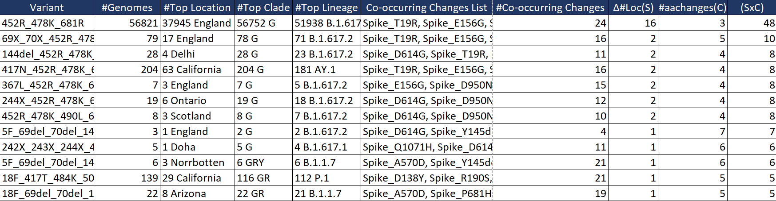
2.1. Read emerging variants
Fig8. First rows of emerging variants table for July 21’

Slide 13
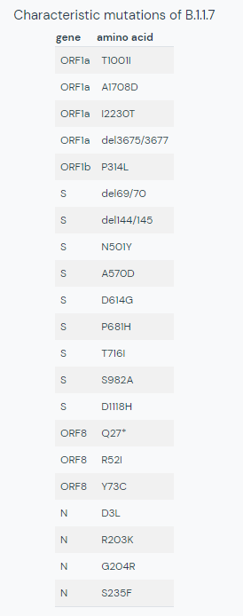

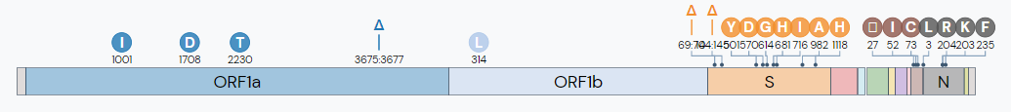
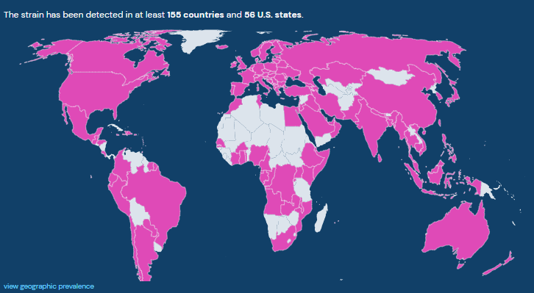
2.2: Extract all Lineages and find metadata
Fig9. B.1.1.7 Lineage Report and table of mutations

Slide 14
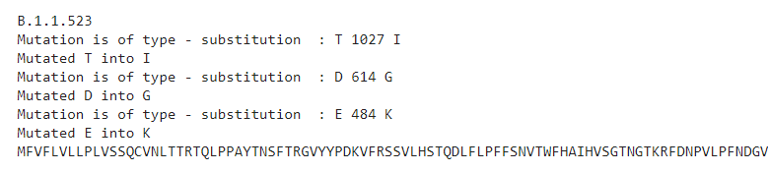
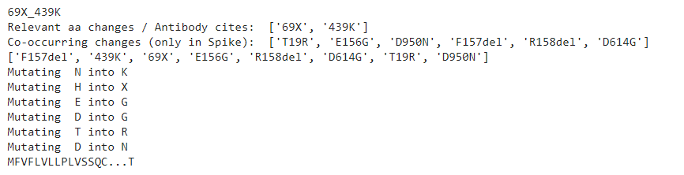
2.3. Create peptides
Fig10. Example outputs of peptide creation for random lineage (up), variant (down)

Slide 15

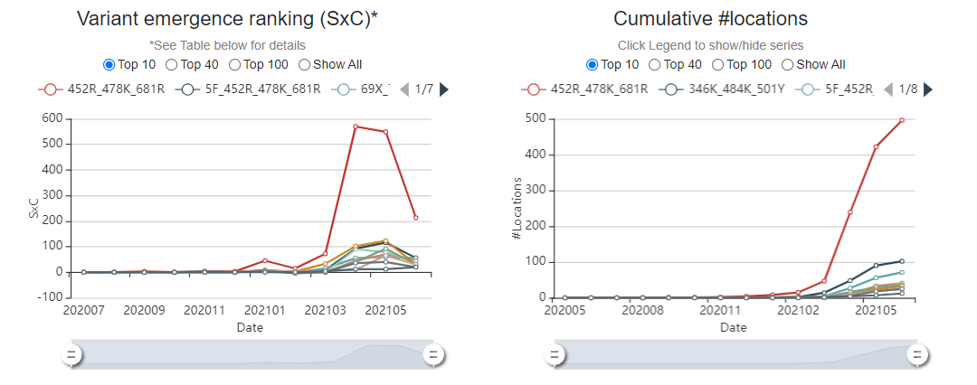
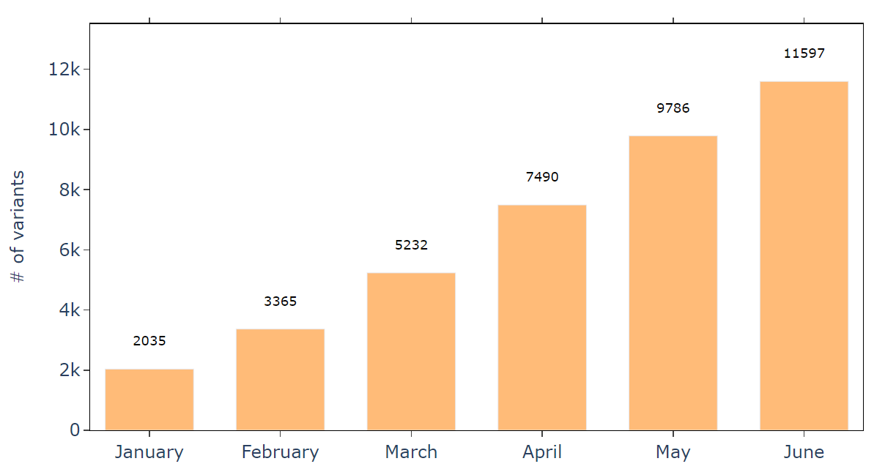
2.4. Cleaning and analyzing data
Fig11. GISAID plots on the emergence ranking and number of locations
Fig12. Number of variants per month

Slide 16
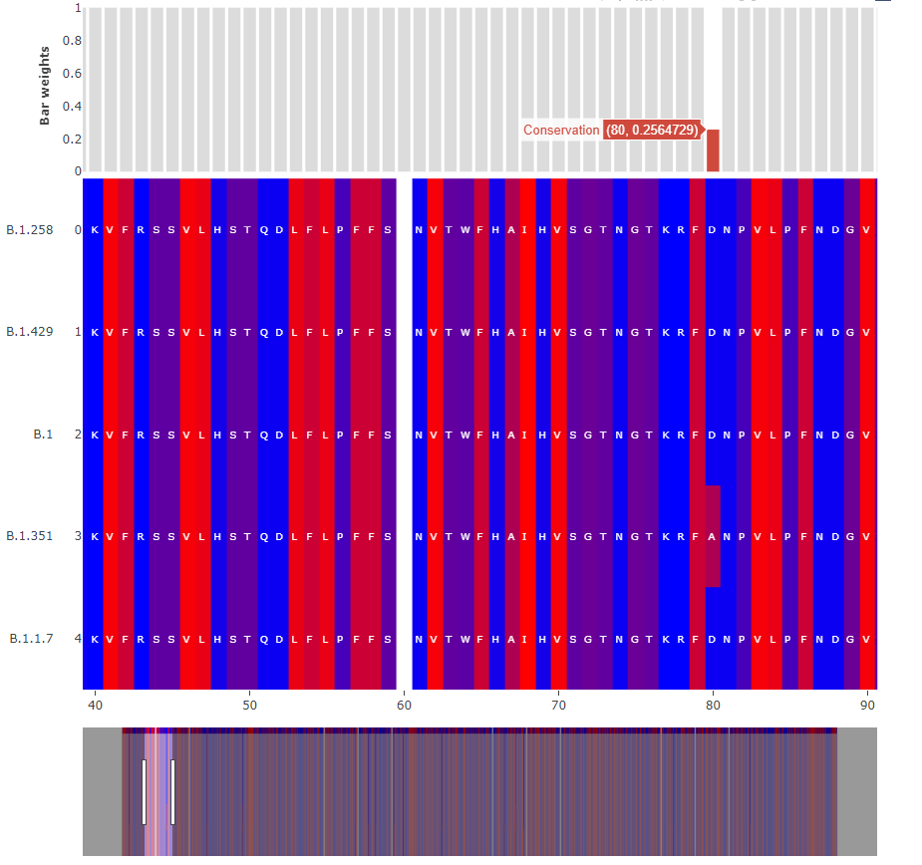
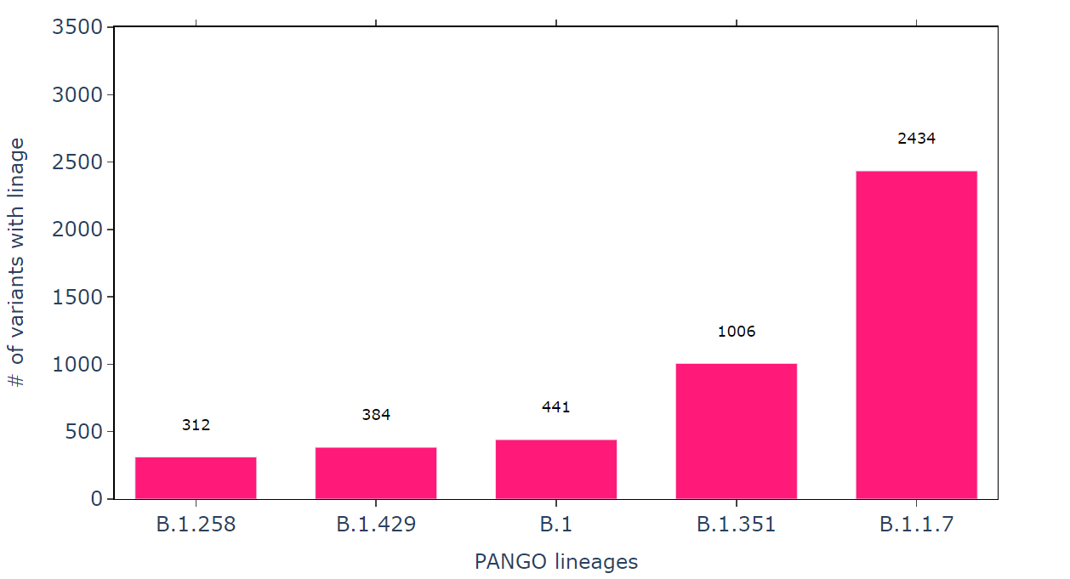
Fig13. Alignment chart and bar plot of the 5 most common lineages

Slide 17
3. Models, Results
What are Transformers?
Attention is all
Training and evaluation
Masking mutations

Slide 18

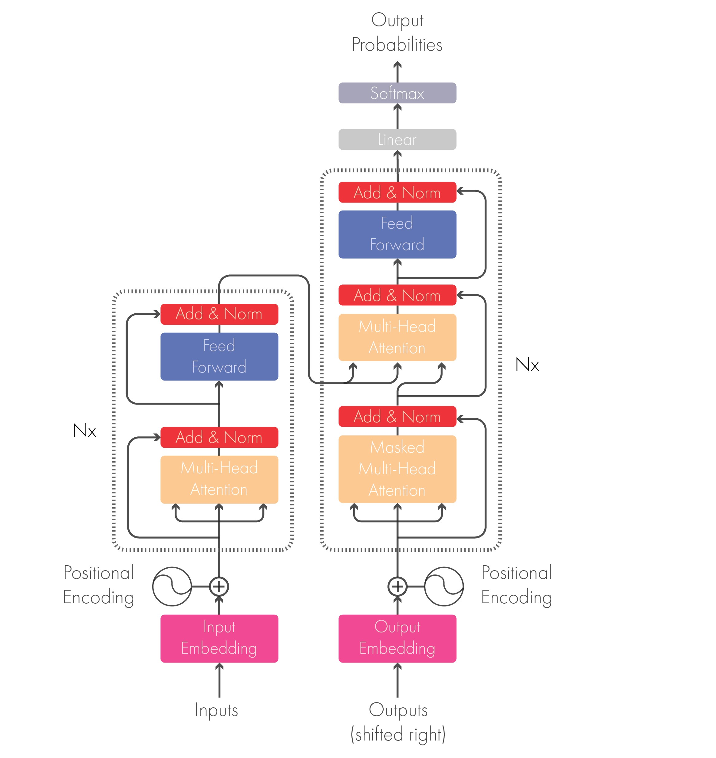
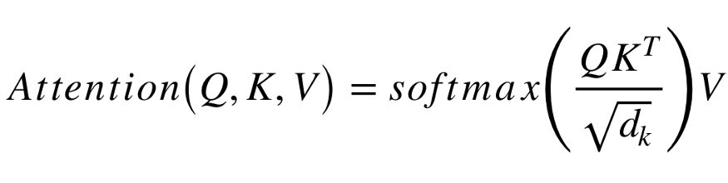
“Attention is all you need”
Fig14. The classical Transformer architecture; diagram (left); formula (right)

Slide 19
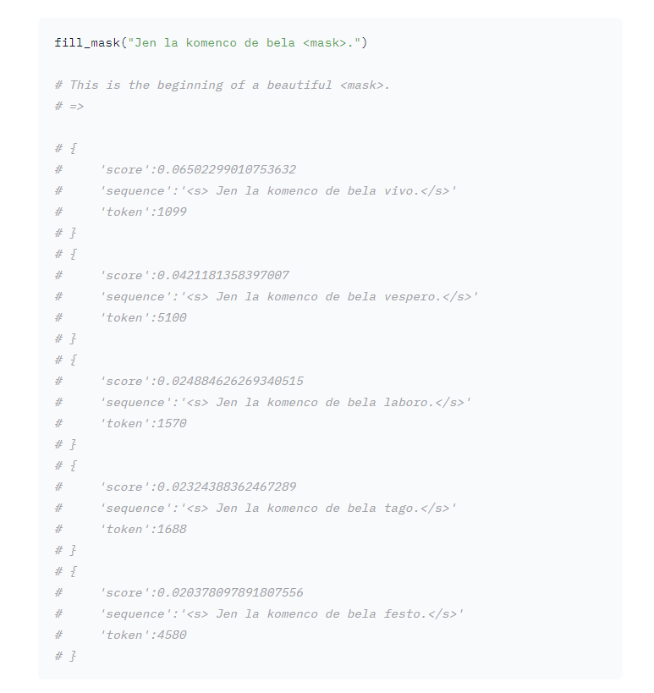
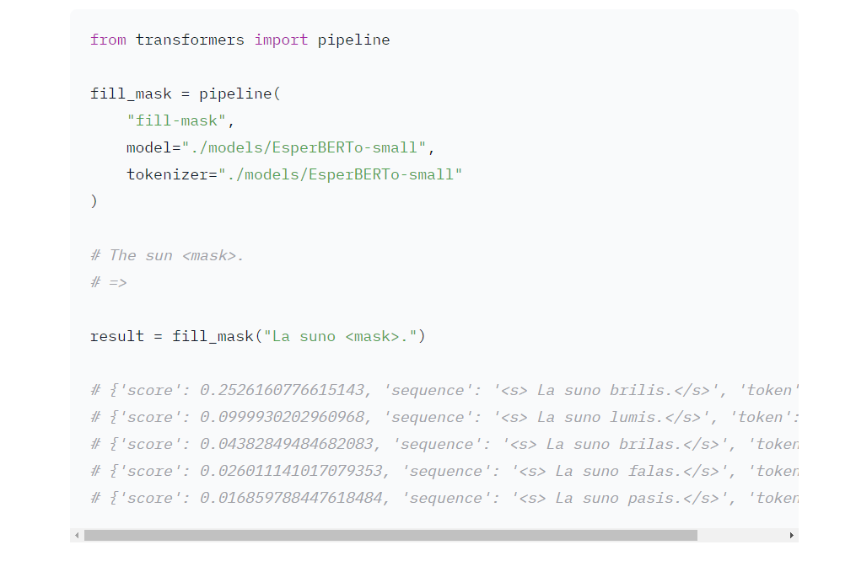
Idea [Esperanto]
Fig15. FillMaskPipeline simple sentence (left), complex sentence (right)

Slide 20
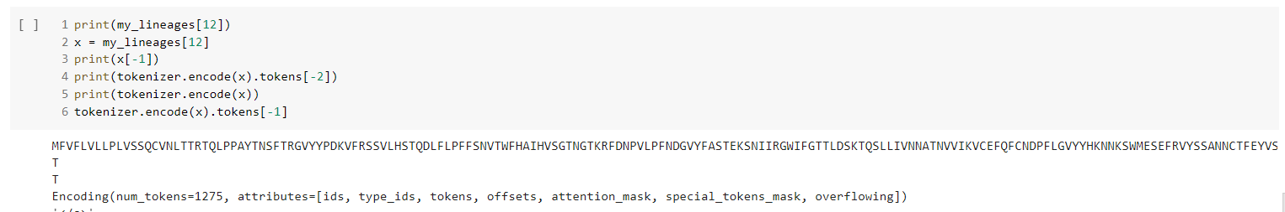
Tokenization
protein sequence from virus
Fig16. Tokenization for random peptide lineage

Slide 21
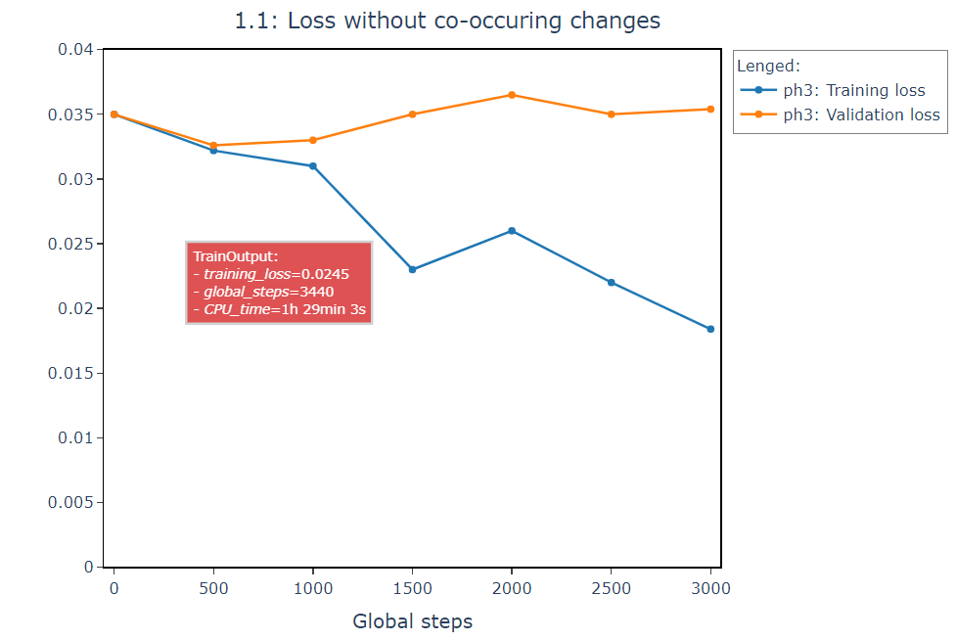
Training [Phase 3]

Slide 22

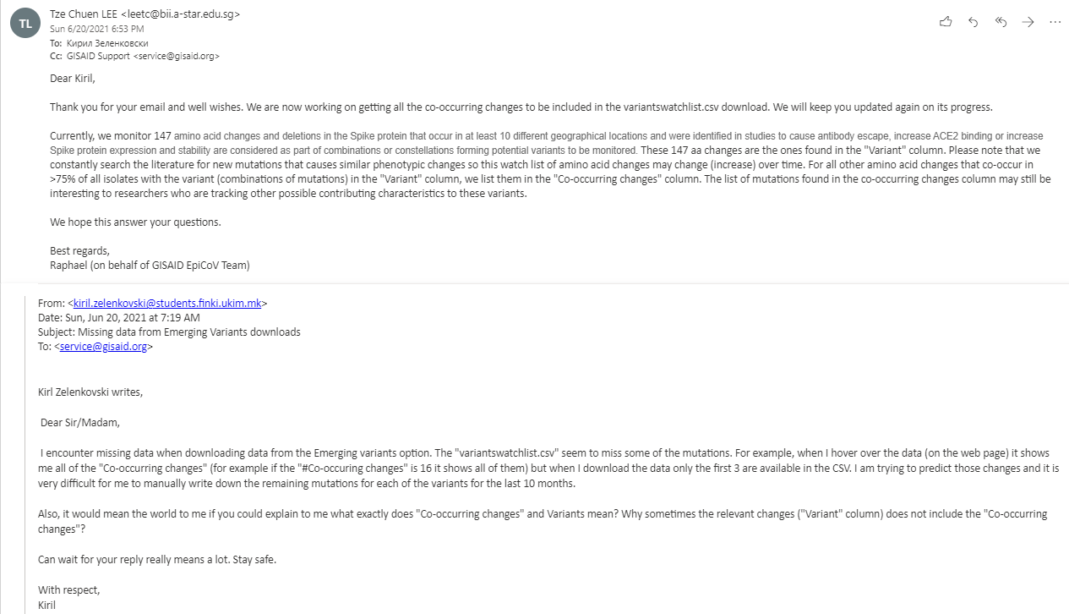

Slide 23
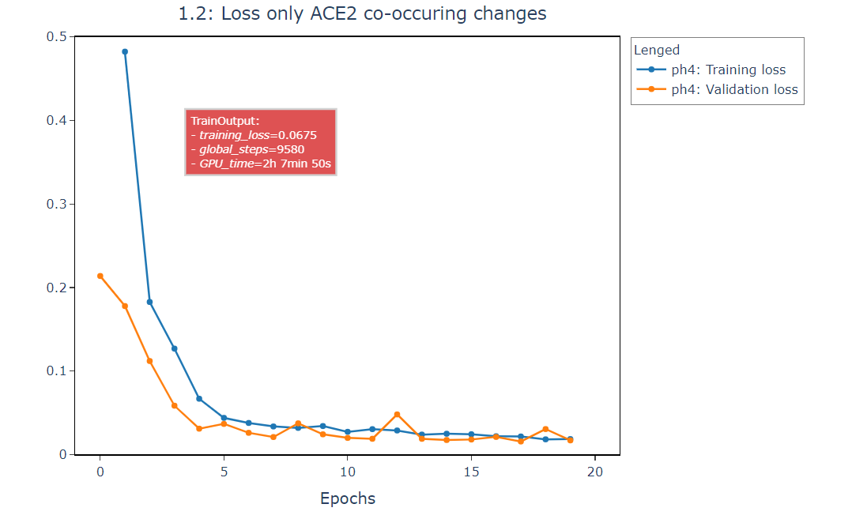
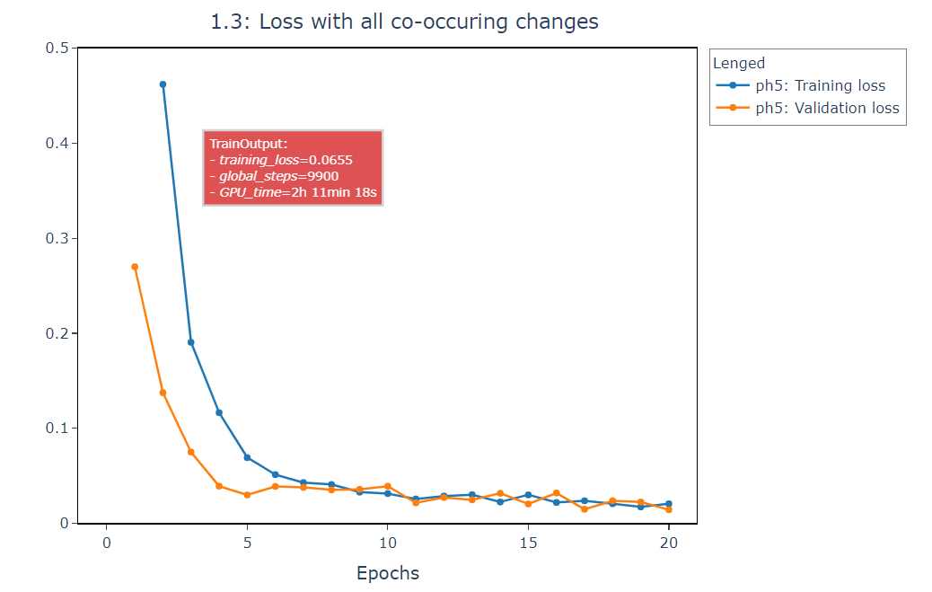
Training [Phase 4 vs. Phase 5]

Slide 24
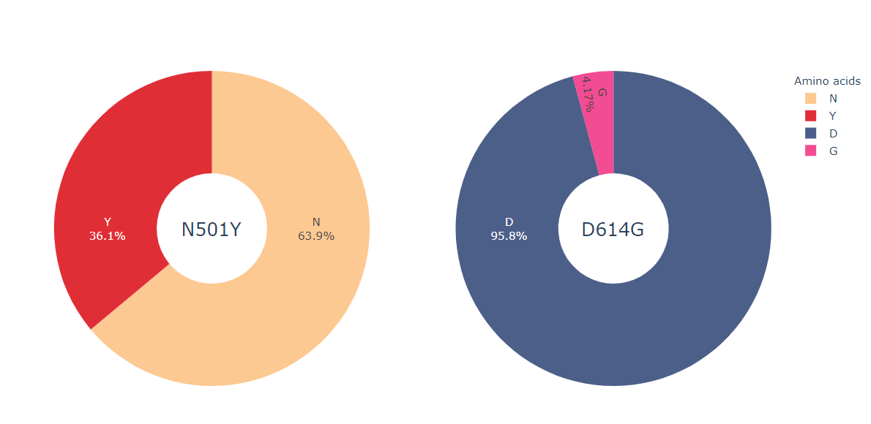
Expected result
Fig17. Expectations based on frequency analysis of position 501 and 614 in input sentences

Slide 25
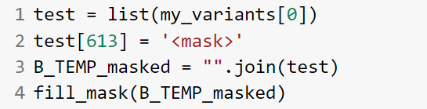
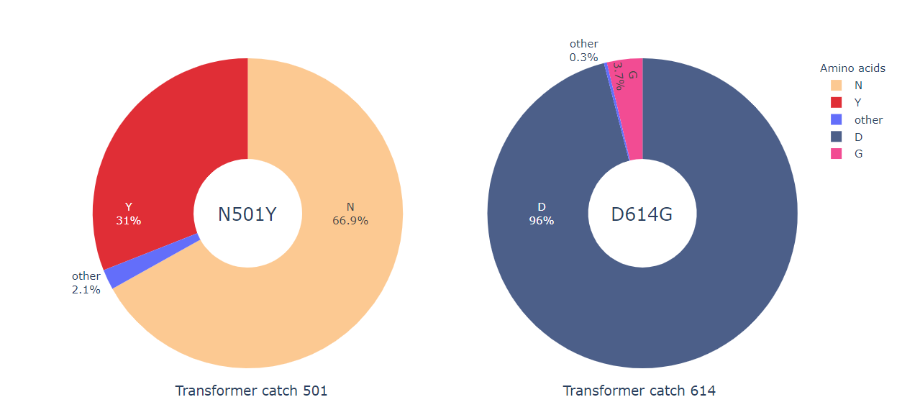
Captured scores
Fig18. Actual scores of the model for mutations N501 and D614G

Slide 26
Improvements?

Slide 27
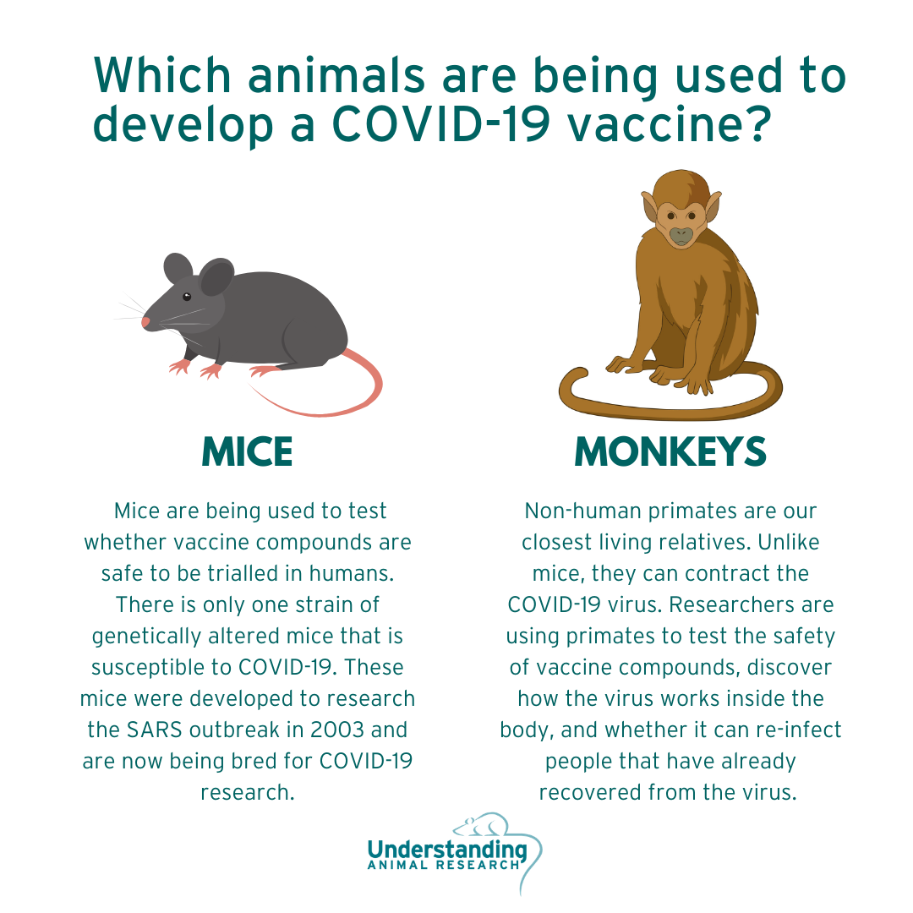
Acknowledgment

Slide 28
Discussion
Mentor:
Phd Prof. Nevena Ackovska
Student:
Kiril Zelenkovski

Slide 29


